Slide 1
Zodiac Signs & Divorce
By: Alishon Mares, Vandrea Foronda

Slide 2
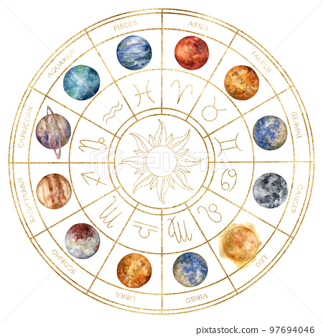
What are Zodiac Signs?
Zodiac Signs refer to one of twelve constellations that the sun passes through
Capricorn
Aquarius
Pisces
Aries
Taurus
Gemini
Cancer
Leo
Virgo
Libra
Scorpio
Sagittarius

Slide 3
Does your zodiac sign have a higher chance for divorce?
Is there a relationship between the zodiac signs and divorce? What are the zodiac signs with the highest rank of divorces? Are there zodiac sign pairings that most likely lead to divorce?
Are larger families more or less impacted by divorce?
How long do the marriages last?
Do income brackets influence divorce?

Slide 4
Top Male Signs

Slide 5
Top Male Signs
Scorpio

Slide 6
Top Male Signs
Scorpio
Sagittarius

Slide 7
Top Male Signs
Scorpio
Sagittarius
Pisces

Slide 8
Top FEMale Signs
Pisces

Slide 9
Top FEMale Signs
Pisces
virgo

Slide 10
Top FEMale Signs
Pisces
Virgo
Libra

Slide 11
PAIRINGS WITH MOST DIVORCES
male
female
Libra + libra

Slide 12
PAIRINGS WITH MOST DIVORCES
male
female
Libra + libra
Sagittarius + virgo

Slide 13
PAIRINGS WITH MOST DIVORCES
male
female
Libra + libra
Sagittarius + virgo
Leo + Aquarius

Slide 14
PAIRINGS WITH MOST DIVORCES
male
female
Libra + libra
Sagittarius + virgo
Leo + Aquarius
Scorpio + virgo

Slide 15
PAIRINGS WITH MOST DIVORCES
male
female
Libra + libra
Sagittarius + virgo
Leo + Aquarius
Scorpio + virgo
Capricorn + Gemini

Slide 16
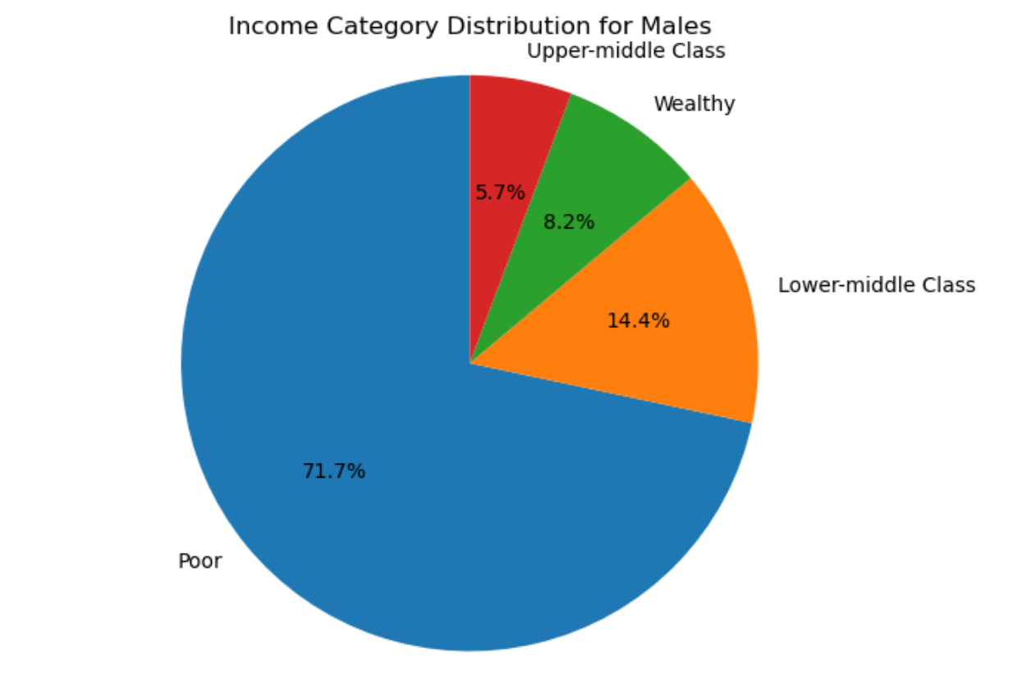
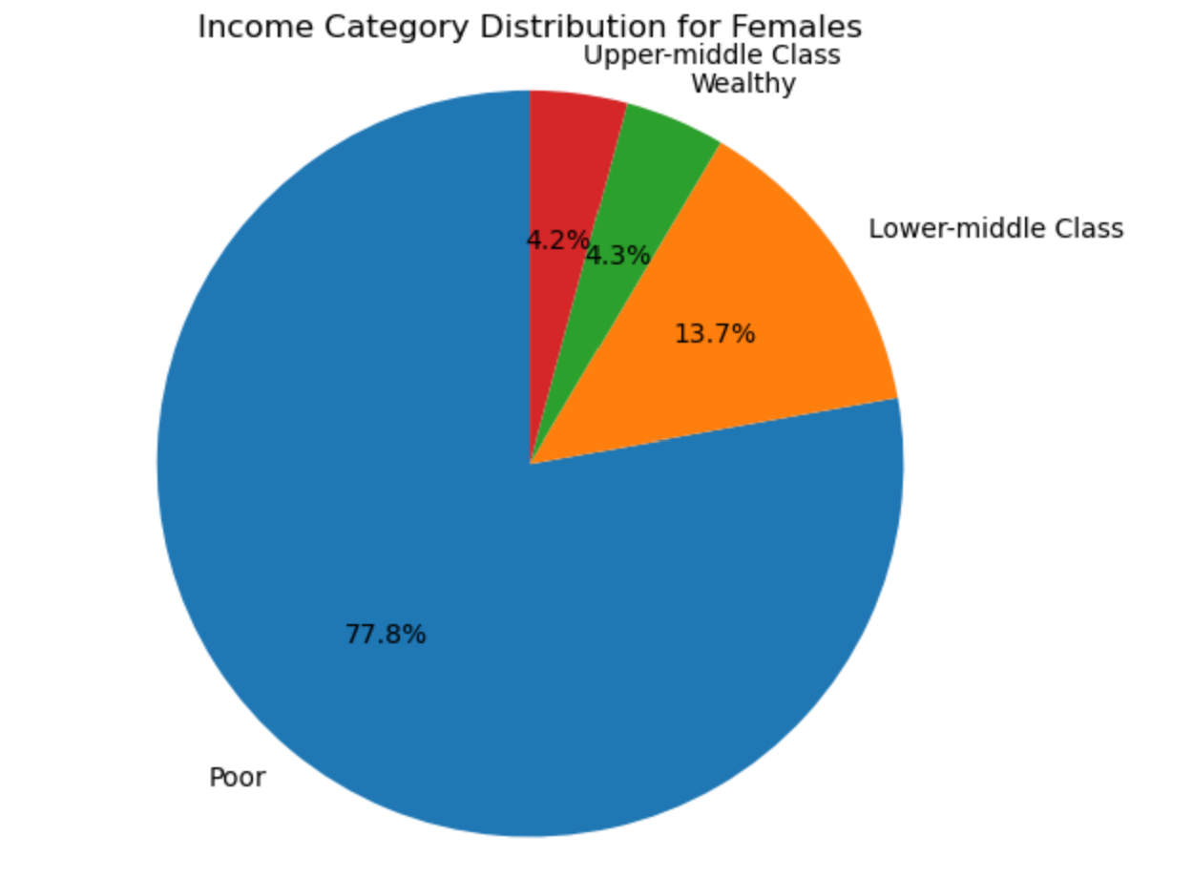
INCOME

Slide 17
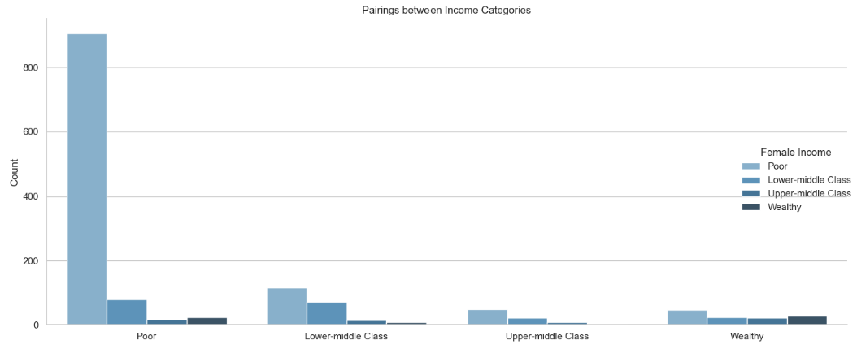
INCOME

Slide 18
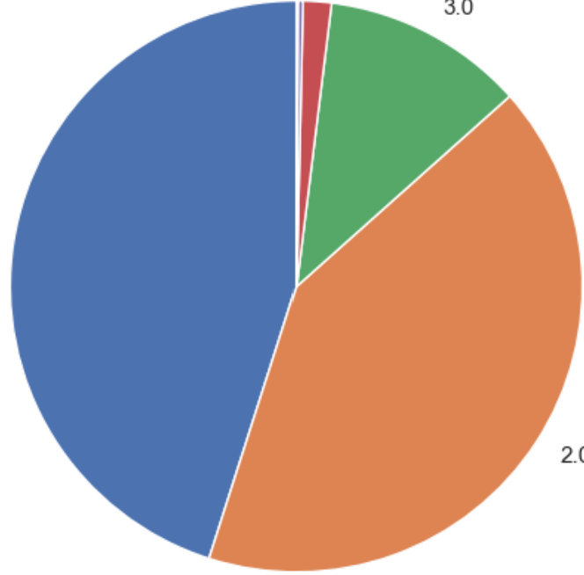
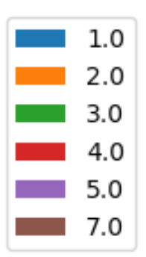
Children
*
0.002%
11.4%
Most divorces occurred after the first or second child
45.1%
41.5%
*

Slide 19
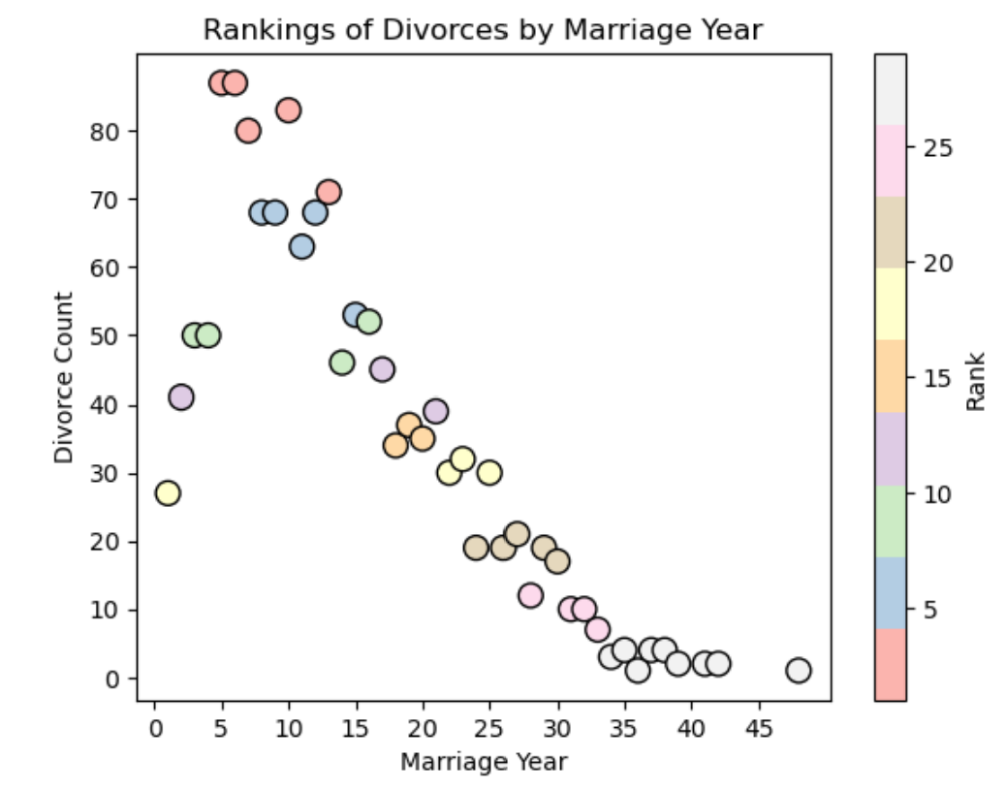
Years Married
Majority of divorces occurred after 5-10 years of being married

Slide 20

Conclusion
While zodiac signs may not directly predict divorce, our research reveals interesting patterns.
Certain zodiac sign pairings seem more susceptible to divorce.
Family size and income brackets also play roles in divorce rates.
Understanding these factors can lead to healthier relationships.

Slide 21


